Slide 1
Data Structures:
Collections

Slide 2
Where we are
Between Prog 110 and 120, at this point you should know how to
Create variable of appropriate types, (including objects from Class defintions and enum types) to hold items of information
Operate on data (add it, concatenate it, modify it, etc.)
Do conditional logic and loop structures
We will now expand your understanding of how to deal with data when you have groups of similar data, such as daily high temperature readings, all the students in a class, all the outstanding invoices for your company, etc.

Slide 3
Storing multiple pieces of data as a group
Array
Collection Classes
ArrayList
Generics
List<T>
Stack<T>
Queue<T>

Slide 4
Array
Can be multi-dimensional
Fixed Size
Datatype is specified
Advantages
Fast execution
Automatic type checking
Can be multi-dimensional
Disadvantages
Must handle expansion or contraction in code
Fruit[] fruitArray = new Fruit[6];

Slide 5
ArrayList
1 dimensional
Grows or shrinks when you add or remove items (nice!)
Any object can be added to the ArrayList
It is most often used in older C# programs, before the Generic List was added.
There is a performance penalty in using ArrayList, particularly on value types. This is because boxing occurs, (which is a way the runtime turns a value type into an object (reference type).
No type checking – any object can be added, usually this is a bad thing that leads to bugs
To use items in an ArrayList, you have to know (or find out) the type of each element
I am not going to cover them in this course, but if you create a method that needs to return several objects of different types, they are useful for that. However the Out tag on the input parameter is maybe a better way.

Slide 6
Generics
Make it possible to design classes and methods that defer the specification of type until the class is declared and instantiated by client code.

Slide 7
Generics
System.Collections.Generic namespace
Contains collection classes that can be typed
List<T>
Stack<T>
Queue<T>
…
Combine the advantages of automatic growth and type checking

Slide 8
<T> Type Parameter
<T> represents a variable type
Type can be specified when the reference variable is declared
List<int> myList = new List<int>();
List<Fruit> myFruitList = new List<Fruit>();

Slide 9
Generics
Avoid the need to create many classes that do the “same thing” but use different types
We don’t need
ListInt
ListDouble
ListDecimal
We just have List<T>

Slide 10
List
Dynamically resize. You can add items, you can remove items anytime.
list.Clear(); will empty the list
IndexOf searches List collections.
Returns the element index of a certain value in the List collection, searches for the first position of the value specified.
When using IndexOf, you must always test for -1 (means none found), or you will get exceptions that you will have to deal with elsewhere
Reverse - reverse all items in the list
Sort
For strings it orders alphabetically.
For integers or other numbers it orders from lowest to highest
For objects, your classes must implement an IComparable<T> interface, and then you decide what is small, what is bigger.

Slide 11
List.count and foreach
static void Main()
{
List<int> list = new List<int>();
list.Add(2);
list.Add(3);
list.Add(7);
foreach (int prime in list) // Loop through List with foreach
{
Console.WriteLine(prime); // prime, or whatever name you want
}
for (int i = 0; i < list.Count; i++) // Loop through List with simple for
{
Console.WriteLine(list[i]); // instead of array.Length, use .Count
}
}

Slide 12
If you make a list of groceries to buy
There may well be no meaning to the order of the list, it’s just all the things to buy.
But if you are making a list of places you’d like to see, or presents you wish your signifigant other would buy you, then the order items are in a list does make a difference.
We will now explore 2 types of “Lists” where the order does matter.

Slide 13
Queue and Stack
If you want to keep a List where the order matters you can use a Queue or a Stack.
The Queue and Stack differ from the List class in that there are limitations on how the Queue and Stack data can be accessed.
Queue – First In, First Out; adding and removing items to a buffer in first come, first served order (Like a line in a bank or grocery store) ; but does not allow random access (no line jumping!)
Stack - First Come, Last Served; less common in real life, but often in programing such as for a recursion, call stack or parsing grammars; also does not allow random access

Slide 14
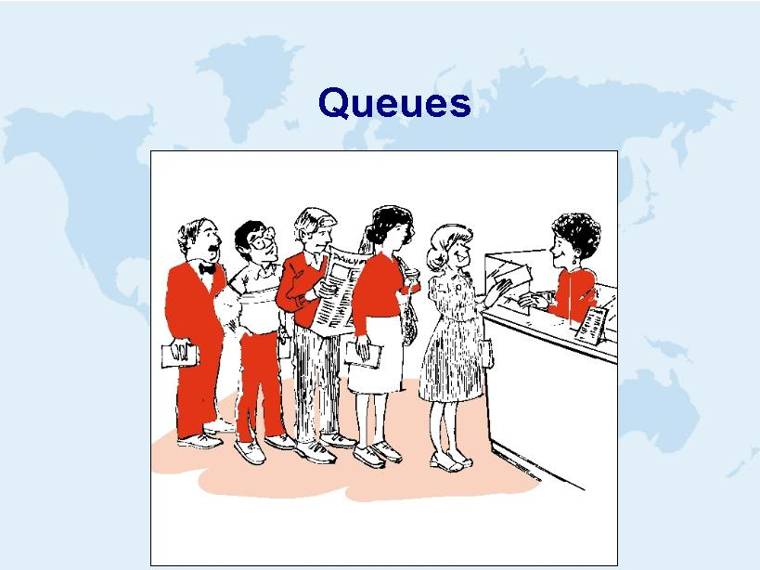

Slide 15
Watch animation: http://www.cs.usfca.edu/~galles/visualization/QueueArray.html

Slide 16
Queue<T>
Queue – First In, First Out; adding and removing items to a buffer in first come, first served order ; but does not allow random access (no line jumping!)
Class that behaves like a line at the bank
Hold multiple objects
Objects enter the queue at the bottom
Objects are removed from the top of the queue
FIFO data structure - First In First Out

Slide 17
Used in cases wherein items need to be serviced in the order in which they arrive
GUI event systems
DB transactions
Asynchronous processes on same or different machines to communicate. (email vs telephone)
Ex: App accepts ads for Craig’s List, takes 3 minutes to process and post
App1
App2
Cust Places ad | New Q depth | Ad Processed
2:01 | 1 | 2:04
2:02 | 2 | 2:07
2:02 | 3 | 2:10
2:08 | 2 | 2:13
2:20 | 1 | 2:23
2:21 | 2 | 2:26
2:23 | 3 | 2:29

Slide 18
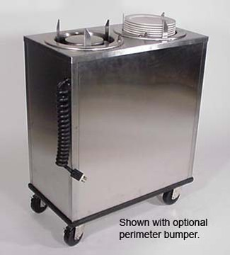
Stacks

Slide 19
Stacks
Watch animation: http://www.cs.usfca.edu/~galles/visualization/StackArray.html

Slide 20
Stack<T>
Stack - First Come, Last Served; less common in real life, but often in programing such as for a recursion, call stack or parsing grammars; does not allow random access (no line jumping!)
Class like a dinner plate device in a cafeteria, push the plates down, pop the top one
Objects enter the stack at the top
Objects are removed from the top of the stack
LIFO data structure - Last In First Out

Slide 21
More uses of stack
Used where reversal of data is needed
“Undo”/ “Redo” feature of Word
Finding one’s way through a maze
Reverse Polish Notation
Depth-First Search of a tree structure (ex: BinarySearchTree.Print), later in course
Detecting palindromes (we’ll do this in code)

